Slide 1
Coders’ Assembly {
Coders_Assembly.py
intro.py
[Code Clinic #2]
instructor = “Tyler”
}
life = “Great” ERROR! Not found!
Notes:
https://drive.google.com/drive/folders/1U_ewpsFA3JDg8NWM7SHbYU7imqgIfTe9?usp=sharing << to release before session

Slide 2
Table Of ‘Contents’ {
01
02
03
forbeginners.html
workshop.css
File Handling
< Exercise 1>
While Loops and Dictionaries
< Exercise 2 >
Final Exercise
< Final Words >
}

Slide 3
01 {
[File Handling]
Coders_Assembly.py
workshop.css
# Reading from a file # Writing to a file
}

Slide 4
What is File Handling?
Coders_Assembly.py
file_handling.py
Accessing files to obtain and process its contents.
Writing into files
In IS111, you will only focus on .txt files or .csv files

Slide 5
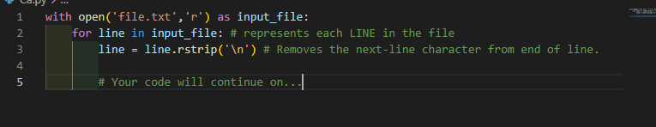
Reading from a file
Coders_Assembly.py
file_handling.py
‘r’ is the param for file READING
File is read line by line via a for loop.

Slide 6
Take NOTE when reading files
Coders_Assembly.py
file_handling.py
Ensure that file to read is in same directory as your python file.
Open the file, see what data you may need to retrieve, and any separating characters.

Slide 7

Writing to a file
Coders_Assembly.py
file_handling.py
‘w’ is the param for file READING
.write() method is used to write content into the file.

Slide 8

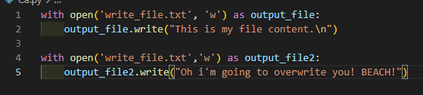
Take NOTE when writing files
Coders_Assembly.py
file_handling.py
.write() does NOT automatically leave a line; you need to include ‘\n’.
If the file you are writing already exists, the python code will OVERWRITE what was already written in that file.

Slide 9
Exercise 1{
# 10 minutes
exercise1.py
Coders_Assembly.py
< Practice your file-writing RIGHT NOW!!! >
}
Notes:
https://docs.google.com/document/d/1srTUrwUgZSaORuSesc7oSwfApRd9Z5JdyXLS29QtCmM/edit?usp=sharing

Slide 10
02 {
[While Loops]
Coders_Assembly.py
whileloop.py
# What are While Loops? # When to use them?
# When to NOT use them.
# Infinite Loop
}

Slide 11
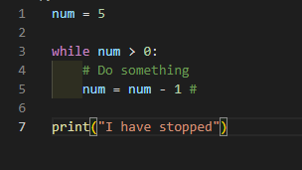
What is a While Loop?
Coders_Assembly.py
whileloop.py
A loop that iterates until its condition becomes FALSE

Slide 12
When to use While Loops?
Coders_Assembly.py
whileloop.py
When you need to repeat code until a certain condition is met
Number of iterations not fixed (unable to use For loop)

Slide 13
When to NOT use While Loops?
Coders_Assembly.py
whileloop.py
When you know how many times you need to repeat code (e.g. given a fixed list of elements; for loop can be used)
When you do not have a CONDITION to set.

Slide 14
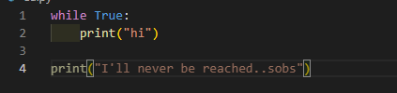
Infinite Loop [DANGER!!]
Coders_Assembly.py
whileloop.py
Occurs when your loop condition NEVER changes to False
Need to restart kernel (Jupyter) or Command Line (VSC)

Slide 15
03 {
[Dictionaries]
Coders_Assembly.py
dictionaries.py
# What is a dictionary?
# Retrieving Dictionary values
# Useful dictionary functions
# When to use dictionaries?
# Things to note
}

Slide 16
What is a Dictionary?
Coders_Assembly.py
dictionaries.py
An unordered collection of data values, used to store data values like a map.

Slide 17

Retrieving Dictionary Values
Coders_Assembly.py
dictionaries.py
value = dictionary[key]

Slide 18
Useful dictionary functions
Coders_Assembly.py
dictionaries.py
Method | Description | Output
my_dict.items() | Get a list containing a tuple of each key-value pair
my_dict.keys() | Get a list containing dictionary’s keys
my_dict.values() | Gets a list containing the dictionary’s values

Slide 19
When to use dictionaries?
Coders_Assembly.py
dictionaries.py
When you want to retrieve values based on specific indexes.
When you are able to categorize a list of values you have.
Notes:
Dictionary = { ‘Anna’: 29, ‘John’ :50 } Dictionary[‘Anna’]

Slide 20
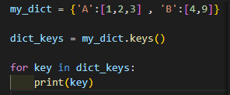
Things to note (Dictionaries)
Coders_Assembly.py
dictionaries.py
When using dict functions, DO NOT use list indexing. Use a for loop instead.
Only immutable elements can be used as dictionary keys (lists can’t be used).

Slide 21
Exercise 2{
# 20 minutes
forbeginners.html
workshop.css
< Practice your While Loops & Dictionaries >
}
Notes:
https://docs.google.com/document/d/1PO61CgHYUBMx2EzZpwVJKrHyQBdpuuXRAbLg9QTUiXE/edit?usp=sharing

Slide 22

Hands-On {
forbeginners.html
workshop.css
Get your hands dirty in this 1 hour plus long exercise!
# 1 hour +
}
Notes:
https://docs.google.com/document/d/1OaKJtT1-kkTA8f6Vn082wfTyiwnLuLMPqCV0DPG3W5w/edit?usp=sharing

Slide 23

Thank you {
if (LT2):
print(“A+”)
}

